Slide 1
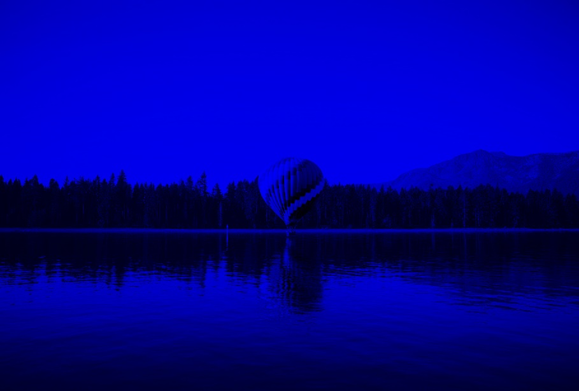
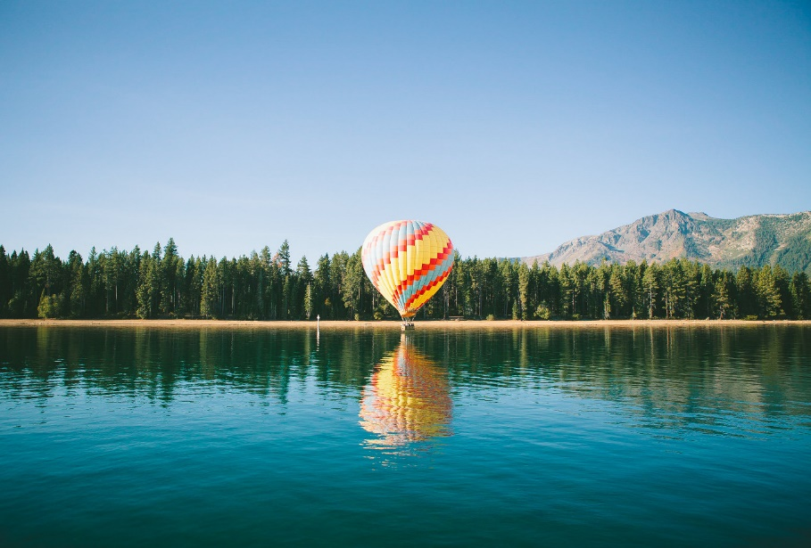
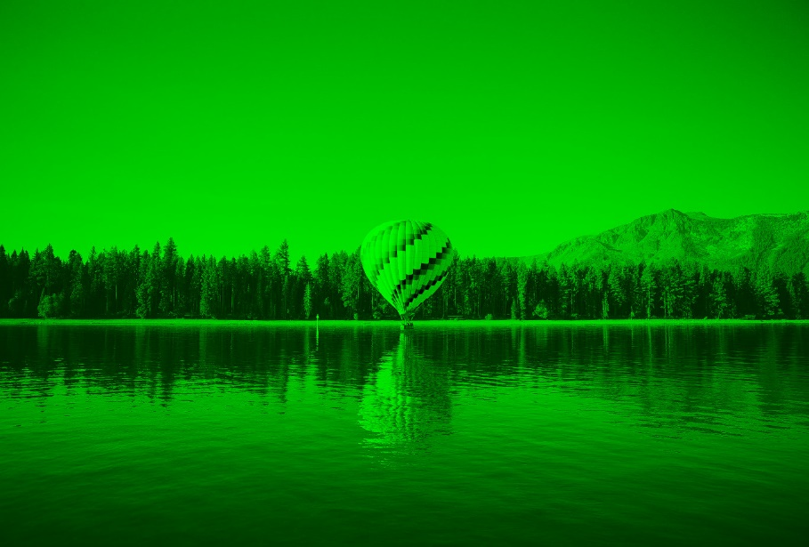
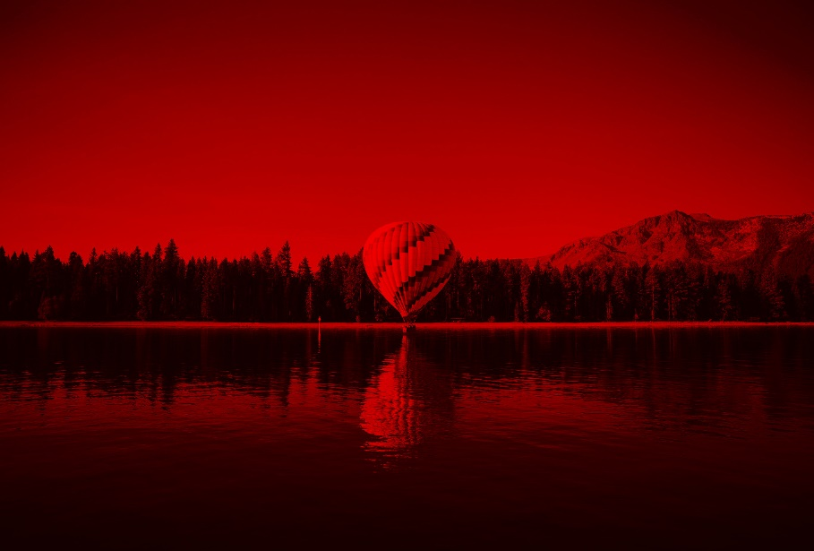

Slide 2
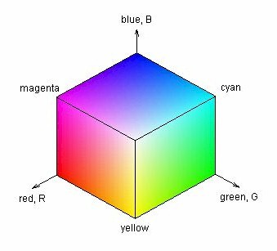
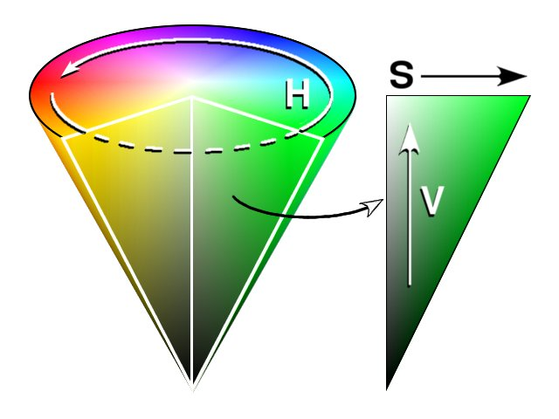

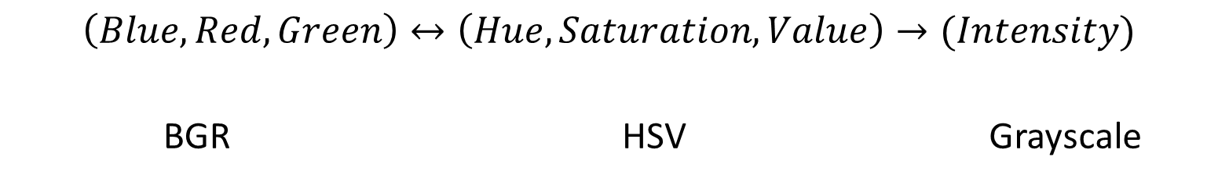
$$\left(Blue, Red, Green\right)↔\left(Hue, Saturation, Value\right)→(Intensity)$$
BGR | HSV | Grayscale
intensity

Slide 3
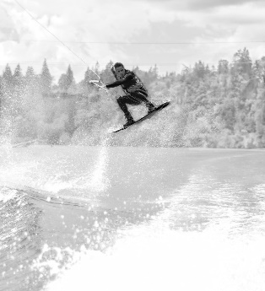
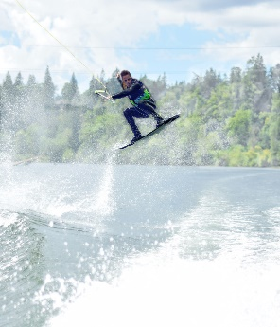
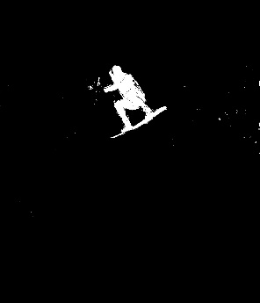
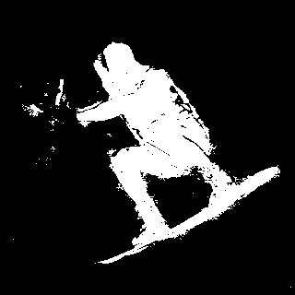
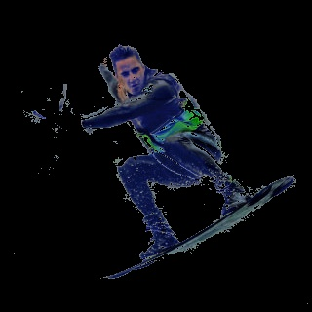
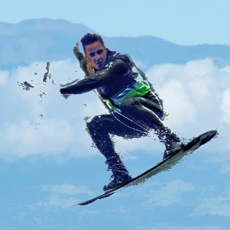
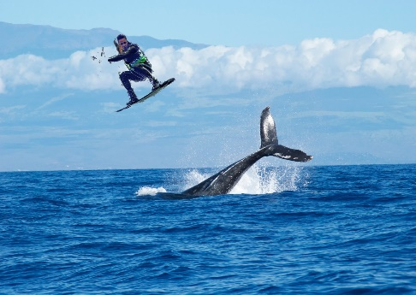
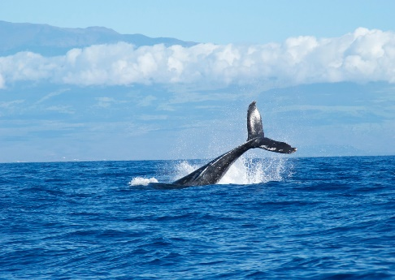
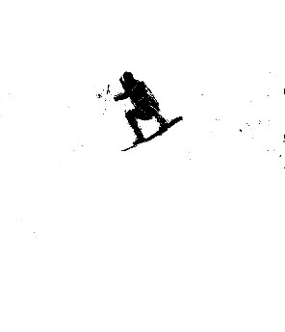
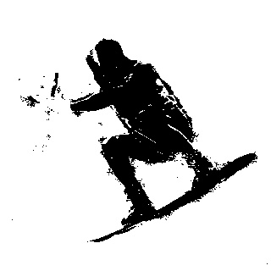
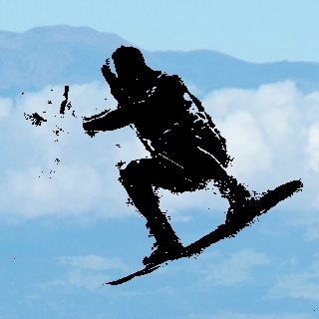
Combine
Image
+
Mask
inRange
threshold
Image
Mask
Binary
operations
Combine
Image
+
Mask
Image
Mask
Image
Mask
Binary
operations
Threshold

Slide 4





Combine
Image
+
Mask
Image
Mask
Binary
operations
Threshold
ROI

Slide 5


Slide 6
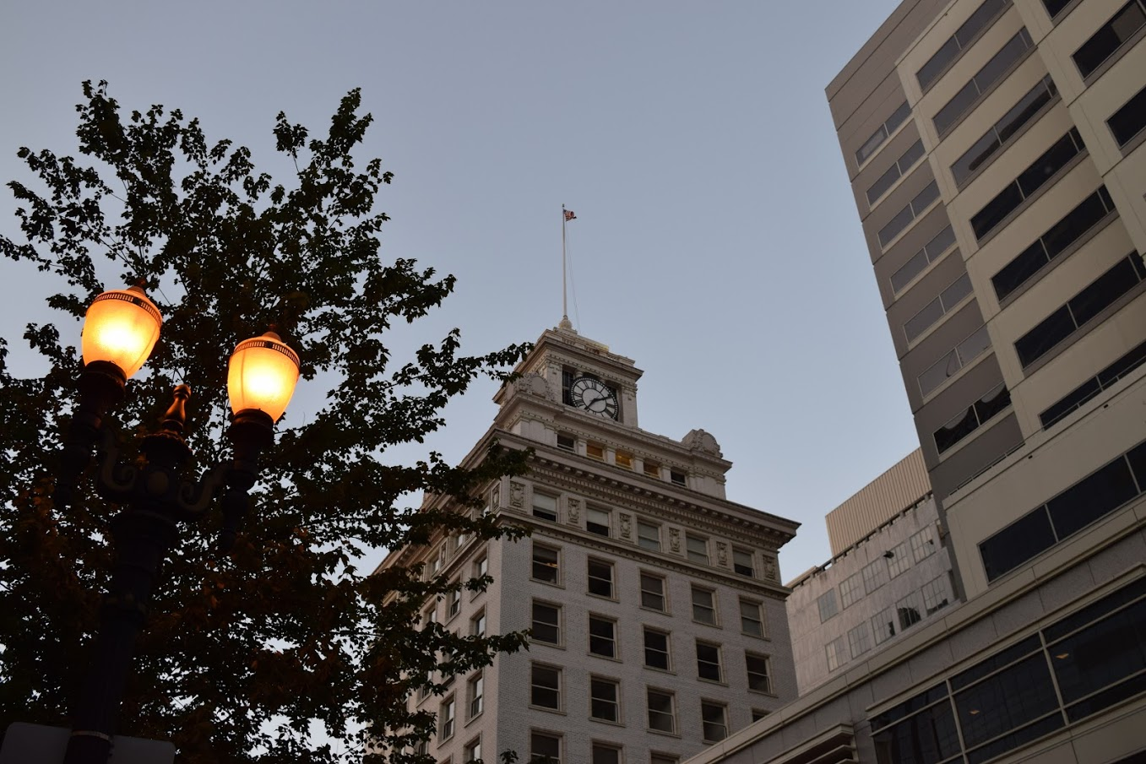
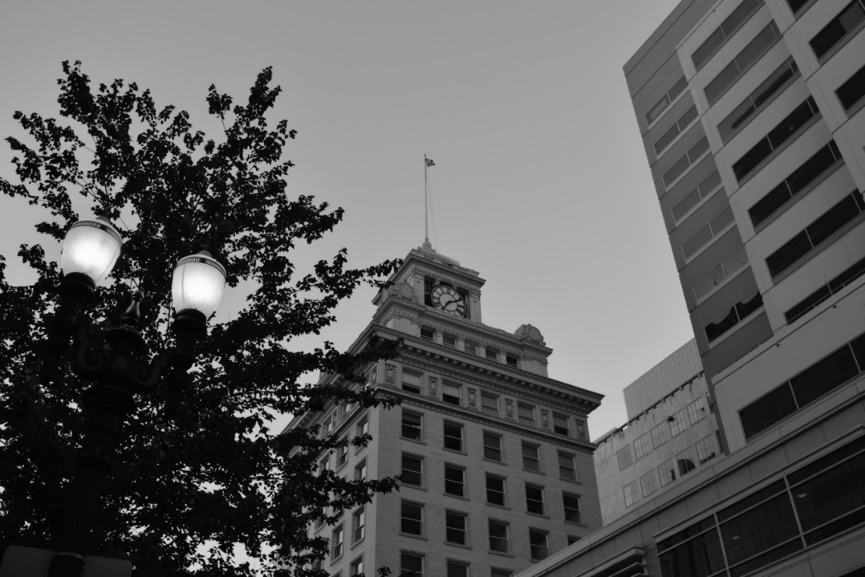
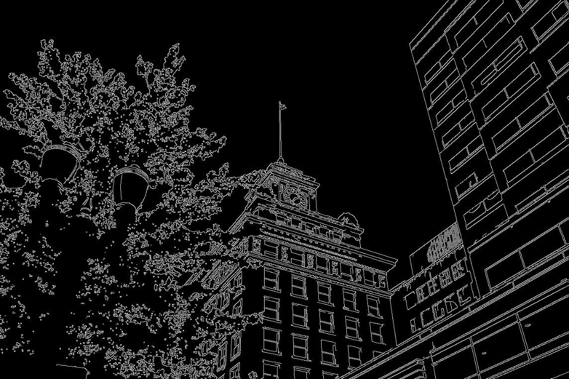
Original
Smoothed
Canny

Slide 7
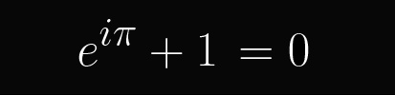
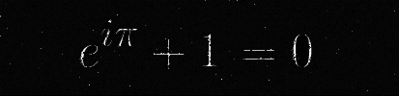
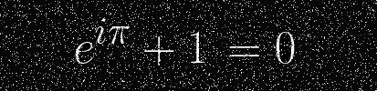
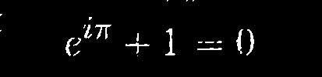
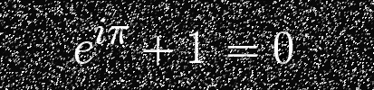
Original
Erosion
Combination
Noisy Image
Dilation

Slide 9
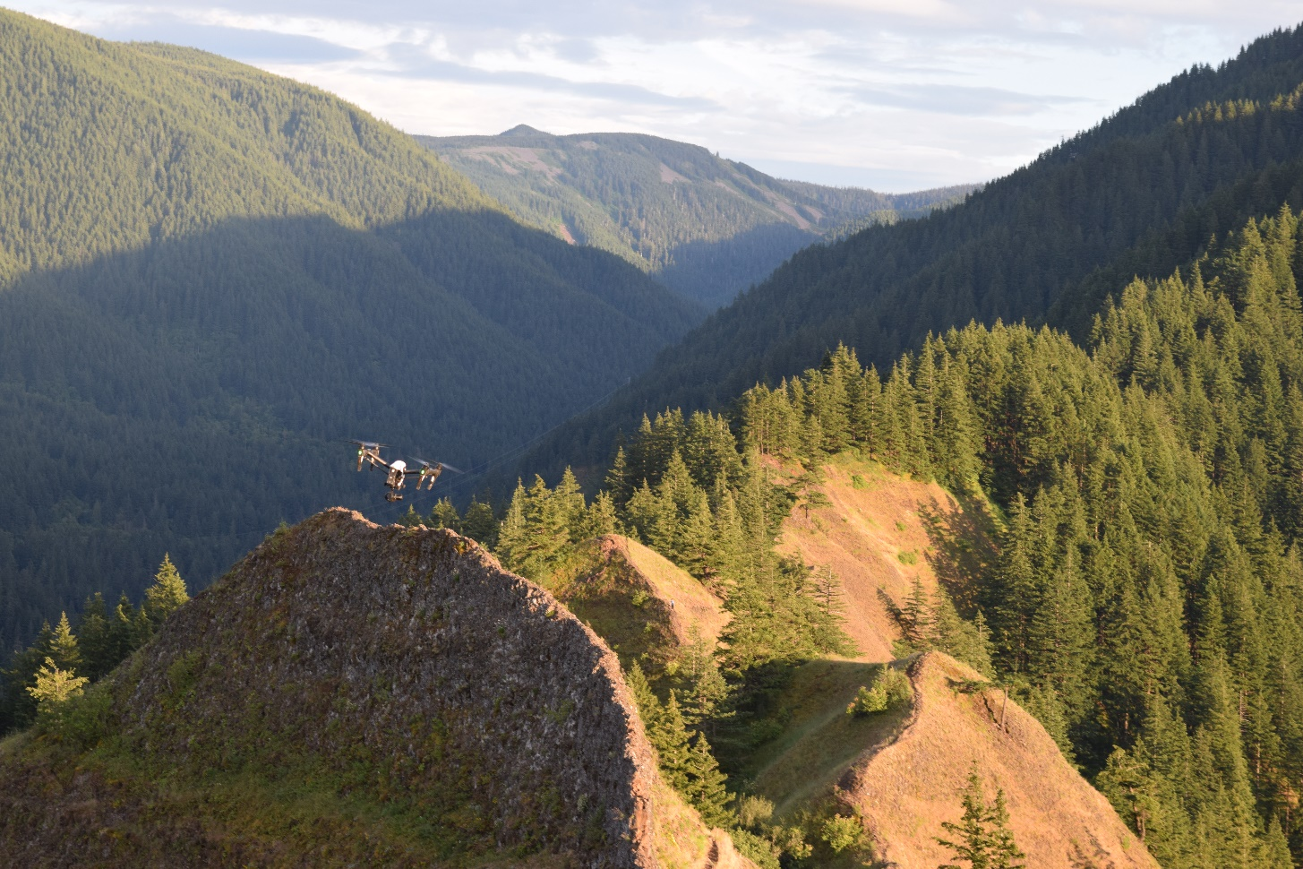
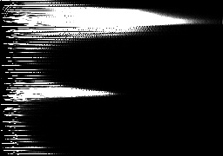
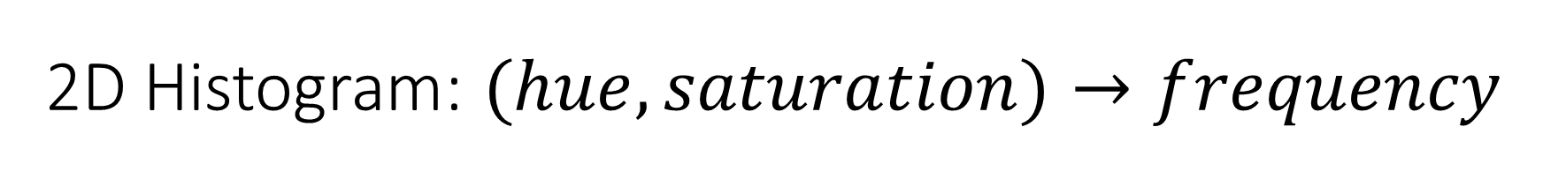
2D Histogram: $(hue, saturation)→frequency$
Hue
frequency
Saturation

Slide 10


Slide 11
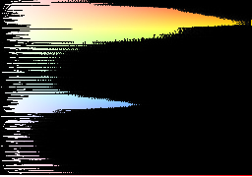

Slide 12
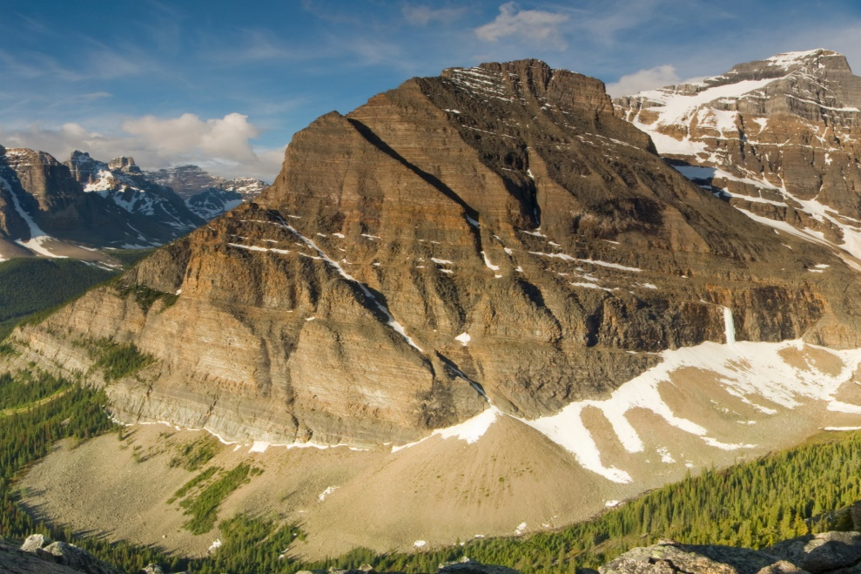
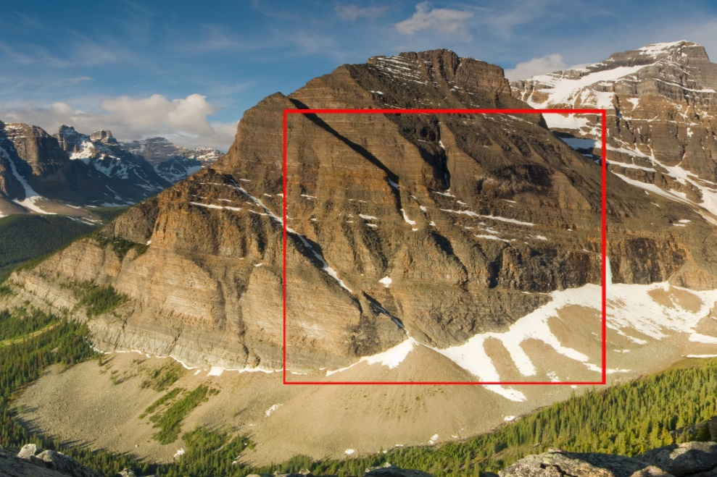
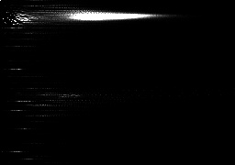
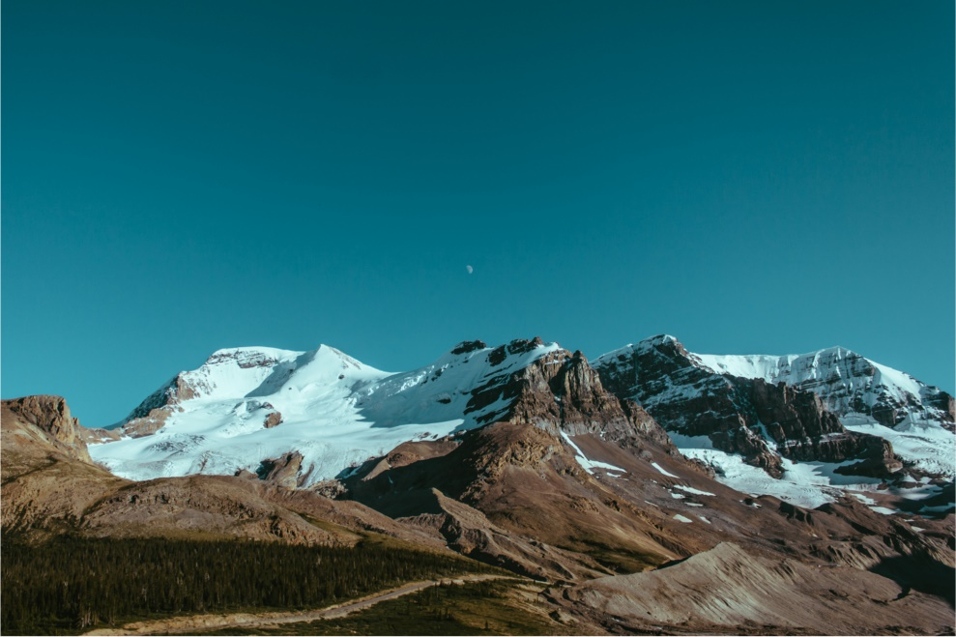
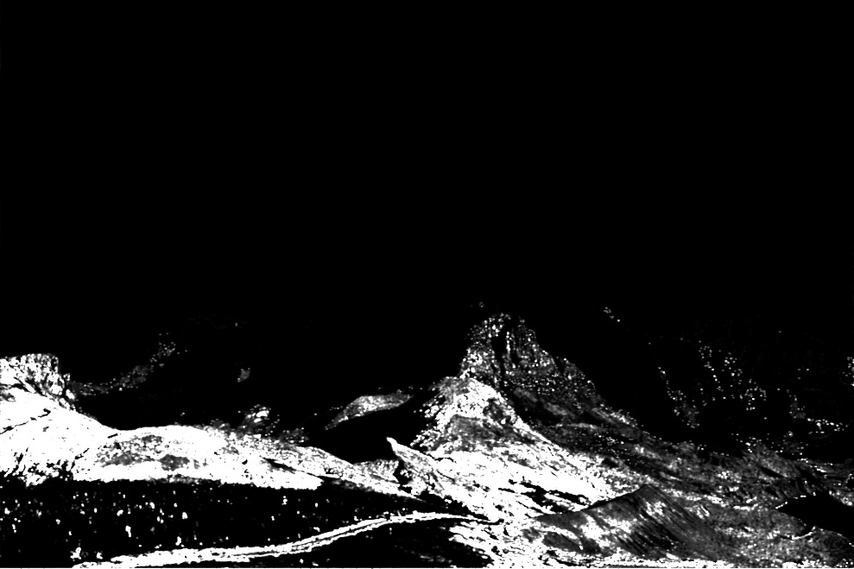
Calculate
region histogram
Select region
create into mask
Back project
Distance
mapping

Slide 13
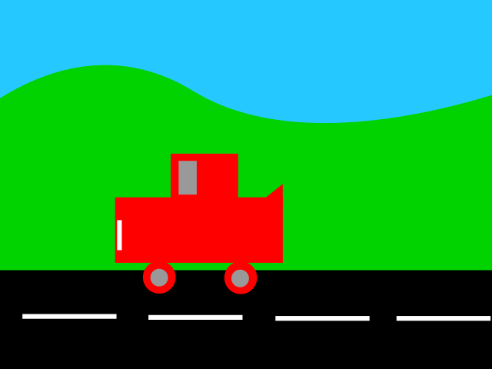
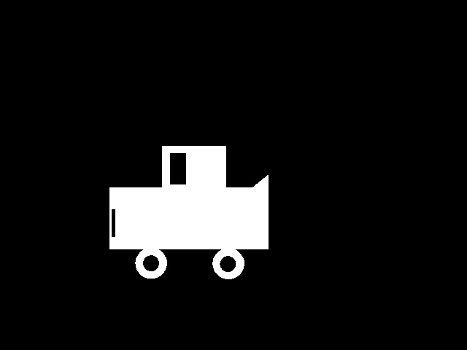
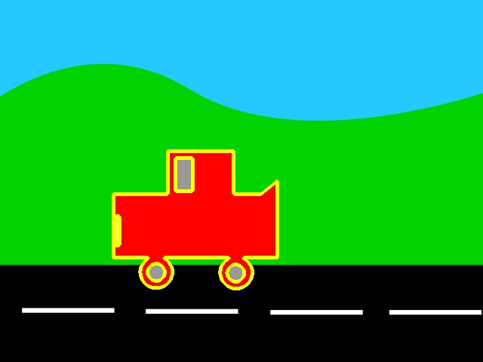

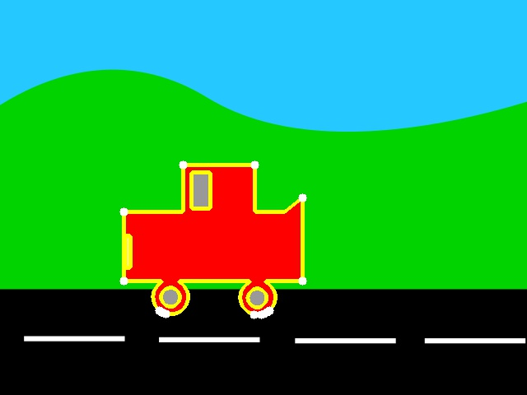
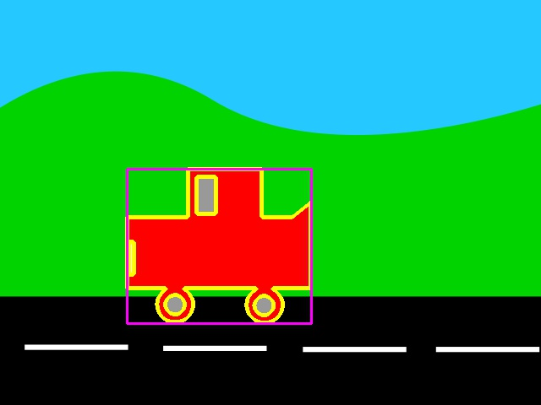

Slide 15
Speed Tracking Demo
if R pressed,
enter ROI /
dash selection
interface
if S pressed,
enter name of pickle file
parse arguments
create perspective matrix
get transformed dashes
load pickled ROI / Dash Data
make contour from ROI
warp the whole perspective
convert color to grayscale
apply Farneback optical flow
convert flow vectors to polar
filter out low-mag noise
only keep vectors in ROI
display flow vectors
p transform on vector endpoints
display rect space vectors
convert rect vectors to polar
find average magnitude of rect vecs
convert rect vec pixel disp to real speed
check if speeding
Send MQTT trigger
Record video for N frames

Slide 16
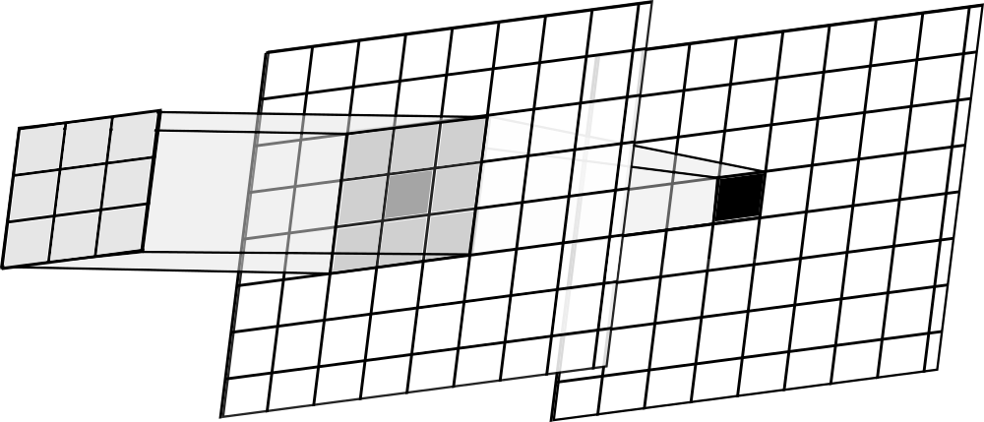
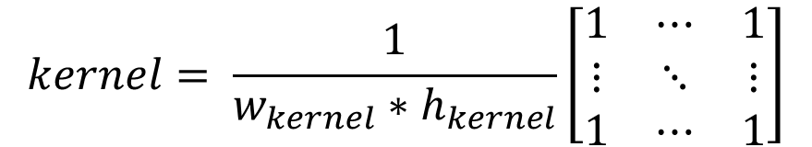
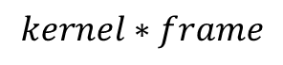
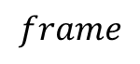
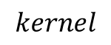
$$kernel= \frac{1}{w_{kernel}∗h_{kernel}}\left[\begin{matrix}1 & ⋯ & 1 \\ ⋮ & ⋱ & ⋮ \\ 1 & ⋯ & 1\end{matrix}\right]$$
$$frame$$
$$kernel∗frame$$
$$kernel$$

Slide 17

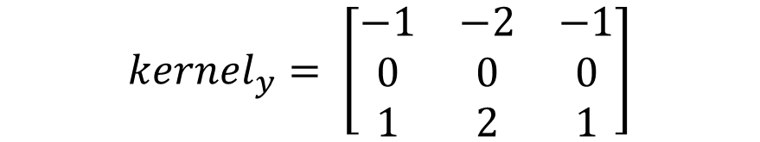


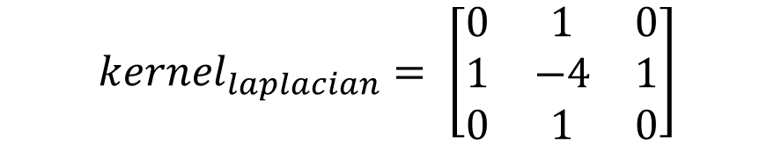
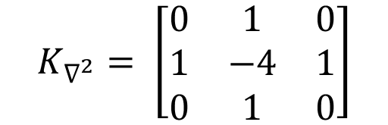

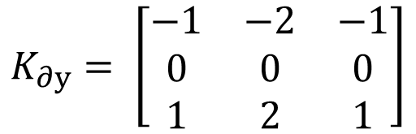
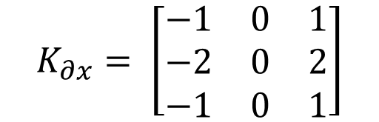
$$kernel_{x}= \left[\begin{matrix}−1 & 0 & 1 \\ ⋮ & 0 & ⋮ \\ −1 & 0 & 1\end{matrix}\right]$$
$$kernel_{y}= \left[\begin{matrix}−1 & ⋯ & −1 \\ 0 & 0 & 0 \\ 1 & ⋯ & 1\end{matrix}\right]$$
$$K_{∂x}= \left[\begin{matrix}−1 & 0 & 1 \\ −2 & 0 & 2 \\ −1 & 0 & 1\end{matrix}\right]$$
$$K_{∂y}= \left[\begin{matrix}−1 & −2 & −1 \\ 0 & 0 & 0 \\ 1 & 2 & 1\end{matrix}\right]$$
$$kernel_{x}= \left[\begin{matrix}−1 & 0 & 1 \\ −2 & 0 & 2 \\ −1 & 0 & 1\end{matrix}\right]$$
$$kernel_{y}= \left[\begin{matrix}−1 & −2 & −1 \\ 0 & 0 & 0 \\ 1 & 2 & 1\end{matrix}\right]$$
$$K_{∇^{2}}= \left[\begin{matrix}0 & 1 & 0 \\ 1 & −4 & 1 \\ 0 & 1 & 0\end{matrix}\right]$$
$$kernel_{x}= \left[\begin{matrix}−1 & 0 & 1\end{matrix}\right]$$
$$kernel_{y}= \left[\begin{matrix}−1 \\ 0 \\ 1\end{matrix}\right]$$
$$kernel_{laplacian}= \left[\begin{matrix}0 & 1 & 0 \\ 1 & −4 & 1 \\ 0 & 1 & 0\end{matrix}\right]$$

Slide 19



Slide 20



$$equalize$$

Slide 21






Slide 22


Slide 23








OpenCV HSV Hues
$$90°$$
$$120°$$
$$60°$$
$$150°$$
$$30°$$
$$180°$$
$$0°$$

Slide 24




Original
Average
Gaussian
Median

Slide 25



Original
Average
Gaussian
Median

Slide 26


Average
Gaussian

Slide 27



$$K= \frac{1}{9}\left[\begin{matrix}1 & 1 & 1 \\ 1 & 1 & 1 \\ 1 & 1 & 1\end{matrix}\right]$$
$$Gaussian curve$$

Slide 28
Speed Tracking Demo
if R pressed,
enter ROI /
dash selection
interface
if S pressed,
enter name of pickle file
parse arguments
create perspective matrix
get transformed dashes
load pickled ROI / Dash Data
make contour from ROI
warp the whole perspective
convert color to grayscale
apply Farneback optical flow
convert flow vectors to polar
filter out low-mag noise
only keep vectors in ROI
display flow vectors
p transform on vector endpoints
display rect space vectors
convert rect vectors to polar
find average magnitude of rect vecs
convert rect vec pixel Δx to realspeed
check if speeding
Send MQTT trigger
Record video for N frames

Slide 29




Dilation
Erosion
Any pixels are on
All pixels are on
All pixels are off
Any pixels are off

Slide 30





$$T$$
$$T(\overset{⃑}{v})$$
$$\overset{⃑}{v}$$

